Slide 1
Emergence of Bangladesh
North South University
Dhaka, Bangladesh
HIS 103, SaMS

Slide 2
THE REVOLT OF 1857

Slide 3
HISTORICAL BACKGROUND
The earliest rebellion was sparked by Fakir-Sannasis in mid-1760s and continued for three decades subsequently. The BEIC banned the offering of money, food, or shelter to the Muslim Fakirs and Hindu Sannasis.
The Tebhaga movement in 1946 launched by the harvesters who demanded two-thirds of the produce for themselves and one-third for the absentee landlords.
Famines, poverty , Class struggle ( Zamimdari system, poor farmers etc. )
British Plundering of Bengal resources
Exploitative land administration & the permanent settlement of 1793
Discontent/ dissatisfaction of the peasants for the expansion of poppy growing areas

Slide 4
The agrarian structure that emerged out of the Permanent Settlement was composed of the zamindars at the top, beneath them the tenure-holders (both independent and dependent), then the ryots, and the under-ryots below them. The sharecroppers, commonly known as bargadars, adhiars and bhagchashis, were at the bottom of the structure, along with the landless labourers or khet-mazdoors .

Slide 5
Features:
Out of hundred plus rebellion that took place over 190 years of colonial rule, the most striking one participated by impoverished farmers was the uprising of 1857
The Revolt of 1857 started at Barrackpur under the leadership of Mangal Pandey on 29 March 1857 and soon spread to Meerut, Delhi and other parts of India. It created serious tension throughout Bangladesh. The resistance in Chittagong and Dhaka and skirmishes at Sylhet, Jessore, Rangpur, Pabna and Dinajpur had left Bangladesh in a state of alert and excitement. The rebellion spread to the various parts of poppy growing areas in northern India. The Revolt of 1857 is regarded as the FIRST INDIAN INDEPENDENCE MOVEMENT/WAR OF INDEPENDENCE
On 18 November 1857 the Native Infantry of Chittagong rose in open rebellion and released all prisoners from the jail. They seized arms and ammunition, ransacked the treasury, set the Magazine House on fire and proceeded towards Tippera.

Slide 6
Several studies indicate that the mass uprising was more serious in the poppy-growing areas of northern India. On the other hand, people in the south generally aided the British colonial government. The most vulnerable areas were Oudh, Rohilkhand, Doad, Meerut, Bengal, Bihar, Benares, Gujarat, Bombay, and Allahabd where the rural population extensively took part with the urban people in the uprising.

Slide 7
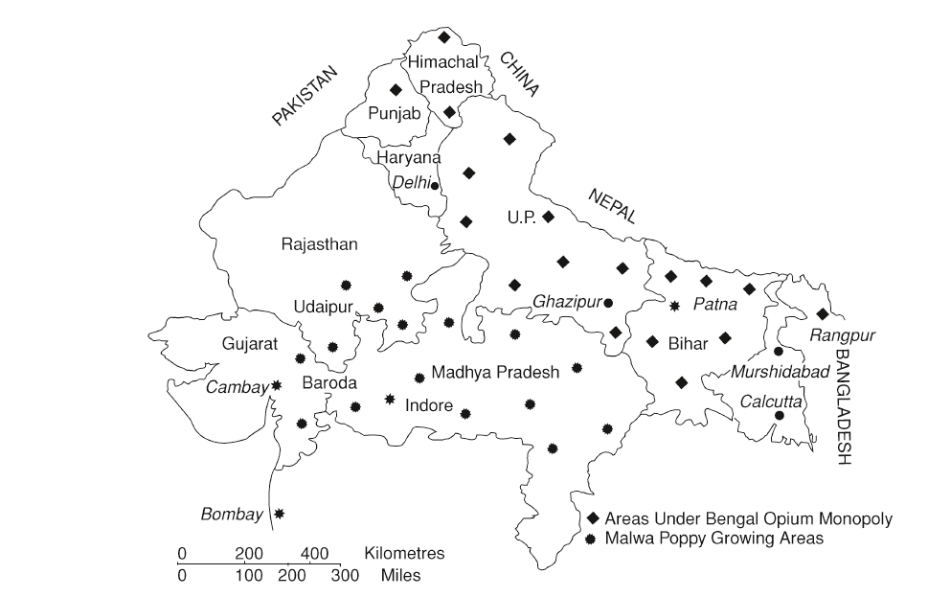
Poppy growing areas in northern India under the BEIC :

Slide 8
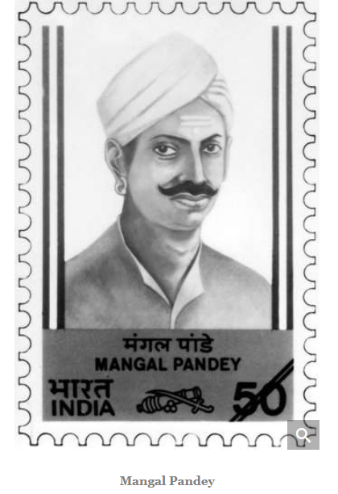
Mangal Pandey : A brave soldier
The rebellion spread to the various parts of poppy growing areas in northern India.

Slide 9
The war was deadly in Oudh, where over 100,000 civilian-armed men joined in the rebellion. The annexation of Oudh in August 1856 was described by Ralph Moore as 'the blackest crime' that England ever committed, and was the 'immediate cause' of the so-called Sepoy Mutiny of 1857.
Upon suppression of the rebellion by 1860, hundreds of Bengali soldiers were hanged to death in and around the Bahadur Shah Park in old Dhaka city today.

Slide 10
A great of twisted and misleading history has been written about the rebellion, amongst which the colonial rulers portrayed it as “Sepoy Mutiny” for the convenience of its suppression.

Slide 11
Mixed Reactions:
The role and reaction of various classes of people of Bangladesh during the revolt present a gloomy picture. The landed aristocracy were decidedly opposed to the sepoys and some of them rendered logistic support to the Company authorities by supplying carts, carriages and elephants; informing the movements of the fleeing sepoys and finally organizing local volunteer corps to resist the sepoys.
The British government acknowledged such services of the landed aristocracy with thanks and subsequently awarded them titles of Nawab, Khan Bahadur, Khan Shaheb, Rai Bahadur, Rai Shaheb etc and rewarded them with all sorts of worldly gains.

Slide 12
The Muslims as a community had an important stake in the uprising on different grounds. The traditional Islamic revivalist groups such as the Faraizi, Tariqah-I-Muhammadiyah, Ahl_I-Hadith , Tabligh Jamaat and the Seerat Conference etc. had active and passive support in the Revolt/Uprising

Slide 13
Causes and Consequences of the Revolt of 1857:
The revolt of 1857 can largely be ascribed to the discontents of local zamindars and poppy cultivators who persistently opposed the colonial opium monopoly system. Under the opium monopoly, the economic conditions of the poppy farmers deteriorated and the strength of the zamindars was undermined. The introduction of forced poppy cultivation sparked mass rebellion in the region of Uttar Pradesh (UP).
The forceful introduction of ‘Enfield Rifle’ ignited both the Hindu and Muslim soldiers to revolt on distinctive religious grounds during 1857-58. COW & PIGS FAT

Slide 14
The annexation of Oudh in August 1856 was described as 'the blackest crime' that England ever committed, and was the 'immediate cause' of the so-called Sepoy Mutiny of1857.
After the mass uprising, the British colonial government came to realize that a policy of ‘divide and rule’ would be effective. Eventually the colonial government continued to pursue a divide and rule policy between the two major communities-the Muslims and the Hindus.

Slide 15
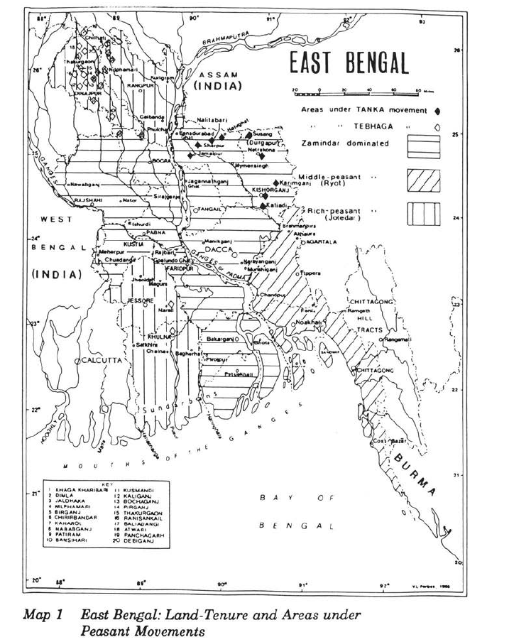

Slide 16
In peasant societies with strong patronage, leaders must have charisma in addition to other qualities to counterbalance the patrons‘ awe and power over their clients. Since patrons are less dependent on their clients, more so in densely populated pre-industrial economies, leaders who can inspire confidence among the latter by providing alternative material, psychological and moral support, can successfully lead them, even against the former.
Peasants under both the zamindar - and jotedar dominated sub-regions had the greatest propensity to follow leaders from outside the peasant community.
Hindu bhadralok vs. Muslim peasants
Kinship (gushti) and lineage (bangsho) were important factors in forming factions.

Slide 17
Subsequent to the rebellion, the patronage and protection of the colonial drug trade was shifted from the BEIC to the Crown government in the UK.
An absence of central planning and dynamic leadership was responsible for the failure of the revolt. Bahadur Shah Zafar was too old to give leadership to such an uprising. During the revolt, a leader like Sir Syed Ahmed Khan took the line of collaboration and compromise with colonial rulers.

Slide 18
Lack of trust and unity among the major communities was equally responsible for the failure of the uprising. In most cases Hindu zamindars, landed aristocrats, 'bhadraloks' and businessmen aided the colonial government by men and material to suppress the revolt.
Financial weaknesses of -the revolutionaries were among other weak points of the revolt.

Slide 19
Use of modern weapons by the British provided strategic advantage to suppress the rebellion.
Conspirators who joined the revolutionaries in disguise also sabotaged the plans and programs of the militants.

Slide 20
After the 1857 revolt, the colonial government had become aware that they had not been quite fair to Muslim interests.
Sir William Hunter in his well-known book, The Indian Mussalmans , published in 1871, pointed out that Muslims had suffered grave injustices, particularly in the matter of administrative and judicial jobs in Bengal.

Slide 21
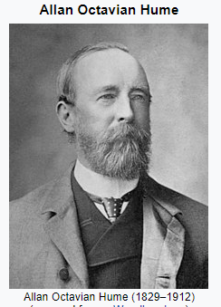
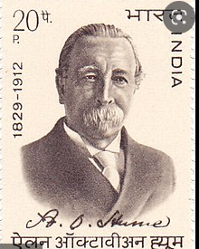
All-India National Congress was formed in 1885 with the support of the British government. The Congress was founded by A. O. Hume who was a former home secretary of India.
Professor Khalid bin Sayeed in his book, entitled, Pakistan: The Formative Phase, wrote that the formation of the Indian National Congress was largely inspired by British influence (Sayeed,1960:29).

Slide 22
The revolt had a popular support base within society and was not just staged by the soldiers alone. Many ulema and down-trodden peasants joined hands with the revolutionary army.
With the failure of the uprising Emperor Bahadur Shah Zafar was deposed and imprisoned, his sons and many other had begun in Delhi in 1204 AD. Although it was generally a Muslim outburst, both Hindus and Muslims took part in the uprising. The revolt also became the benchmark of the end of BEIC rule and the imposition of direct Crown rule instead. With this, Jawaharlal Nehru maintains in his The Discovery of India, 'India becomes for the first time a political and economic appendage of another country’.

Slide 23
Question and Answer

